Slide 1

Summary of Sales Analysis
Years 2011-2014

Slide 2

Adventure Works Cycles
The company has branches in various locations.
Its goal is to promote the sport of cycling worldwide.
The company specializes in the sale of bicycles and related equipment.

Slide 3

Product/Service Quality
High-quality products or services to meet customer expectations.
Commitments to customer satisfaction, including efficient support and issue resolution:
regularly introducing new and improved products or services.
maintain transparency in business operations, pricing, and communication.

Slide 4

Sales Department
Generating revenue and facilitating the exchange of goods or services with customers.

Slide 5
Overall sales strength and pick of the sales
Total revenue generated and profit of the businesses
Findings of Research
Results
There was a rise in revenue over the years 2011-2013
A consistent trend shows that before winter holidays stands out as profitable period over the years.
Summer season relatively high revenues across multiple years.
Activities associated with this particular month tend to exhibit strong financial performance and well financially during winter and summer holidays;
Potential seasonal trends or business patterns, emphasizing the significance of year-end performance and the relatively strong start to each fiscal year.
Notes:
The last quarter consistently stands out as the most profitable period.
The third quarter consistently exhibits relatively high revenues compared to other quarters.

Slide 6
Annual Sales
In 2011 and 2014 there are only partial data, so they must be analyzed monthly by comparing with corresponding months in subsequent/previous years.
2013 was more successful than 2012. This is evident in the increases: 50% in the quantity of items sold, 76% in the amount of sales and 20% in profits

Slide 7
June and July emerge as months with relatively high revenues across multiple years.
The Lowest Revenue Month February
Winter is less favorable for cycling
Less Sales

Slide 8
November stands out as profitable period over the years.

Slide 9
The last quarter consistently stands out as the most profitable period.
The third quarter consistently exhibits relatively high revenues compared to other quarters.

Slide 10
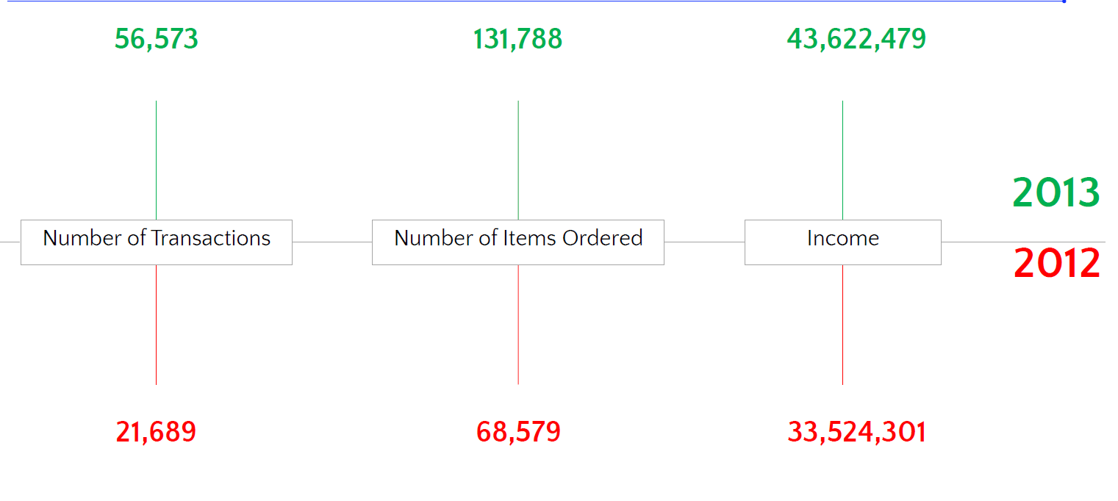
Is the an upward /downward trend in the company's performance over the years?

Slide 11
Which products are top sellers?
The most sold and profit Product Category
LL Touring Frame - Blue, 58
ML Mountain Frame-W - Silver, 38
LL Mountain Frame - Black, 40
LL Road Seat/Saddle
LL Touring Frame - Blue, 62
LL Mountain Frame - Black, 52
HL Mountain Frame - Black, 44
LL Touring Frame - Blue, 44
LL Touring Frame - Yellow, 58
LL Mountain Frame - Silver, 48
The analysis of sales data indicates a
notable trend wherein accessories consistently outperform clothes in
terms of sales.

Slide 12
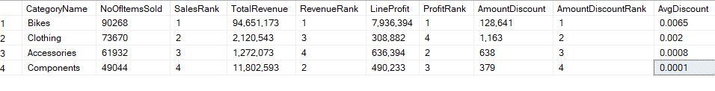
Category Bikes is the most sold from all categories and has the highest revenue, profit and amount of discount.

Slide 13
Recommendations
Based on the analyasis, we recommend the following actions:
Invest in Data-Driven Marketing strategies to boost sales and personalize promotions during peak sales quarters to maximize revenue.
Understanding customer preferences and adapting product offerings accordingly.
Prioritize marketing efforts towards customer segments with high Lifetime Value (LTV), making them valuable for sustained business growth.

Slide 14

Large image

Slide 15

Thank You

